Slide 2
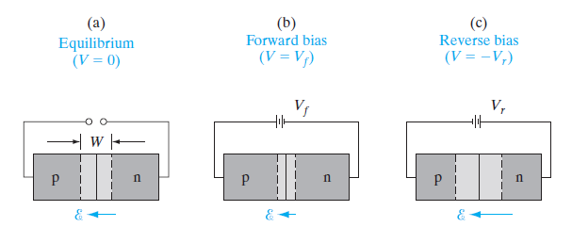

Slide 3
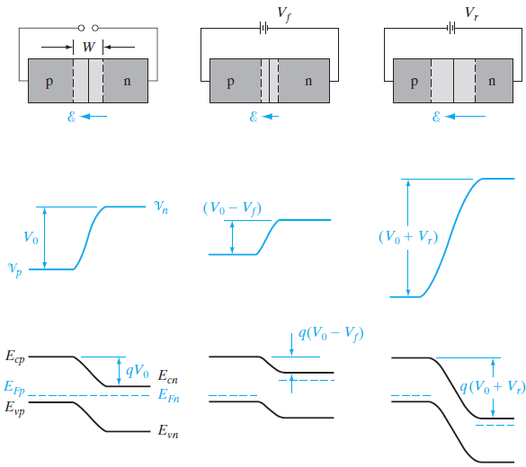

Slide 4
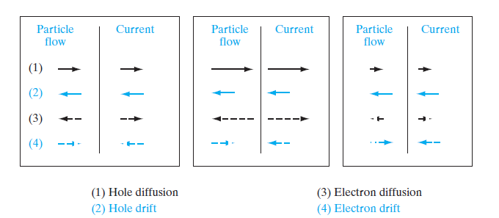

Slide 5
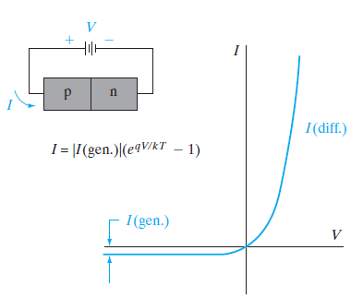

Slide 6
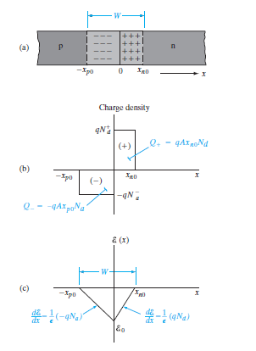

Slide 7


The minority carrier concentration on each side of a p-n junction to vary with the applied bias because of variations in the diffusion of carriers across the junction.
The equilibrium ratio of hole concentrations on each side becomes with bias.
This equation uses the altered barrier V0 - V to relate the steady state hole concentrations on the two sides of the transition region with either forward or reverse bias (V positive or negative).

Slide 8

For low-level injection we can neglect changes in the majority carrier concentrations.
Although the absolute increase of the majority carrier concentration is equal to the increase of the minority carrier concentration in order to maintain space charge neutrality, the relative change in majority carrier concentration can be assumed to vary only slightly with bias compared with equilibrium values.
With this simplification we can write the ratio as
With forward bias, Eq suggests a greatly increased minority carrier hole concentration at the edge of the transition region on the n side p(xn0) than was the case at equilibrium.

Slide 9
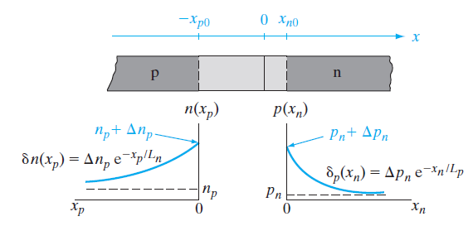
Conversely, the hole concentration p(xn0) under reverse bias (V negative) is reduced below the equilibrium value pn.
The exponential increase of the hole concentration at xn0 with forward bias is an example of minority carrier injection.
Fig. suggests, a forward bias V results in a steady state injection of excess holes into the n region and electrons into the p region.
We can easily calculate the excess hole concentration Δpn at the edge of the transition region xn0 by subtracting the equilibrium hole concentration from

Slide 11
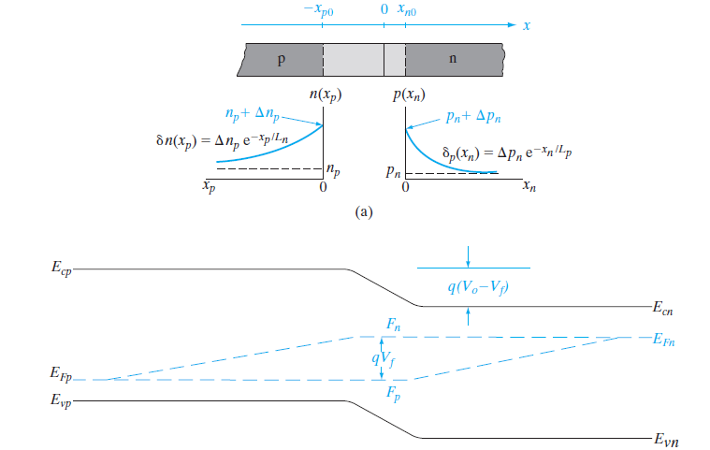

Slide 12
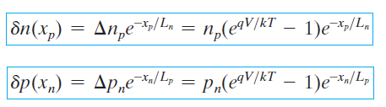

Distributions of excess carriers (𝞭n and 𝞭 p) assuming long p and n regions:
The hole diffusion current at any point xn in the n material can be found as:
where A is the cross-sectional area of the junction.
Lp is hole diffusion length
Ln is electron diffusion length
Dn is electron diffusion coefficient

Slide 13
Thus the hole diffusion current at each position xn is proportional to the excess hole concentration at that point.
The total hole current injected into the n material at the junction can be obtained simply by evaluating above Eq at xn0:

Slide 14


Thus the hole diffusion current at each position xn is proportional to the excess hole concentration at that point.
The total hole current injected into the n material at the junction can be obtained simply by evaluating above Eq at xn0:
By a similar analysis, the injection of electrons into the p material leads to an electron current at the junction of

Slide 15
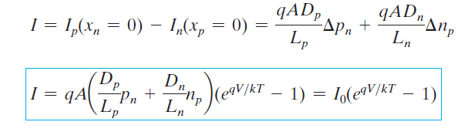
The minus sign in Eq. means that the electron current is opposite to the xp-direction; that is, the true direction of In is in the +x direction, adding to Ip in the total current.
The total diode current I at xn0 can be calculated as the sum of Ip(xn = 0) and -In(xp = 0).

Slide 16
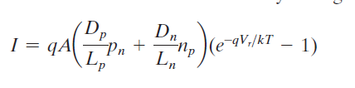
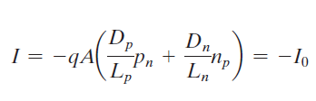
Equation is the diode equation, having the same form as the qualitative relation.
Nothing in the derivation excludes the possibility that the bias voltage V can be negative; thus the diode equation describes the total current through the diode for either forward or reverse bias.
We can calculate the current for reverse bias by letting
V = -Vr:
If Vr is larger than a few kT>q, the total current is just the reverse saturation current

Slide 17
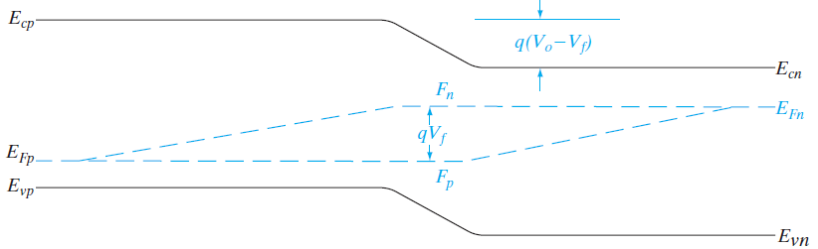

Figure shows the quasi-Fermi levels as a function of position for a p-n junction in forward bias.
The equilibrium EF is split into the quasi- Fermi levels Fn and Fp which are separated within W by an energy qV caused by the applied bias, V.
In forward bias in the depletion region we get

Slide 18
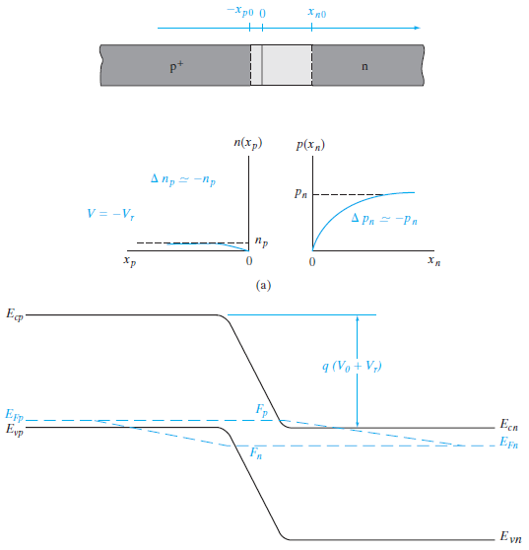
REVERSE BIAS

Slide 19


Thus for a reverse bias of more than a few tenths of a volt, the minority carrier concentration at each edge of the transition region becomes essentially zero as the excess concentration approaches the negative of the equilibrium concentration.
The excess minority carrier concentrations in the neutral regions are still given by Eq, so that depletion of carriers below the equilibrium values extends approximately a diffusion length beyond each side of the transition region.

Slide 20

This reverse-bias depletion of minority carriers can be thought of as minority carrier extraction, analogous to the injection of forward bias.
Physically, extraction occurs because minority carriers at the edges of the depletion region are swept down the barrier at the junction to the other side and are not replaced by an opposing diffusion of carriers.

Slide 21
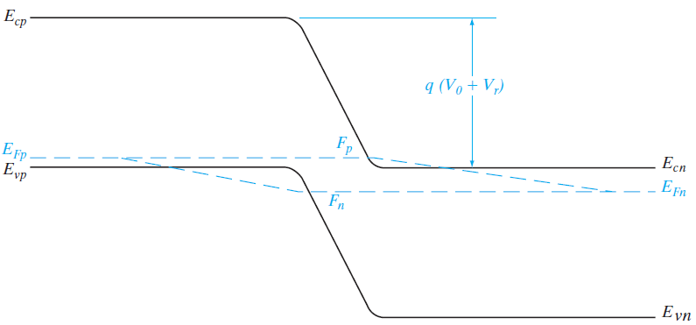
In reverse bias, the quasi-Fermi levels split in the opposite sense than in forward bias (Fig. 5–18b).
The Fn moves farther away from Ec (close to Ev) and Fp moves farther away from Ev , reflecting the fact that in reverse bias we have fewer carriers than in equilibrium, unlike the forward bias case where we have an excess of carriers.

Slide 22

In reverse bias, in the depletion region, we have

Slide 23
A p-n junction biased in the reverse direction exhibits a small, essentially voltage-independent saturation current.
This is true until a critical reverse bias is reached, for which reverse breakdown occurs.
At this critical voltage (Vbr) the reverse current through the diode increases sharply, and relatively large currents can flow with little further increase in voltage.
The existence of a critical breakdown voltage introduces almost a right-angle appearance to the reverse characteristic of most diodes.
There is nothing inherently destructive about reverse breakdown.
If the current is limited to a reasonable value by the external circuit, the p-n junction can be operated in reverse breakdown as safely as in the forward-bias condition.

Slide 24
The maximum reverse current which can flow in the device of Fig. 5–19 is (E - Vbr)>R; the series resistance R can be chosen to limit the current to a safe level for the particular diode used.
If the current is not limited externally, the junction can be damaged by excessive reverse current, which overheats the device as the maximum power rating is exceeded.
Reverse breakdown can occur by two mechanisms, each of which requires a critical electric field in the junction transition region.
The first mechanism, called the Zener effect, is operative at low voltages (up to a few volts reverse bias).
If the breakdown occurs at higher voltages (from a few volts to thousands of volts), the mechanism is avalanche breakdown.

Slide 25
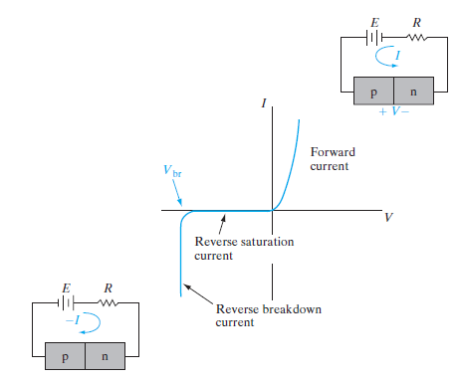

Slide 26
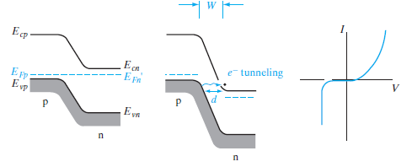
Zener Breakdown
When a heavily doped junction is reverse biased, the energy bands become crossed at relatively low voltages (i.e., the n-side conduction band appears opposite the p-side valence band).
Fig indicates, the crossing of the bands aligns the large number of empty states in the n-side conduction band opposite the many filled states of the p-side valence band.

Slide 27
If the barrier separating these two bands is narrow, tunneling of electrons can occur.
Tunneling of electrons from the p-side valence band to the n-side conduction band constitutes a reverse current from n to p; this is the Zener effect.
The basic requirements for tunneling current are a large number of electrons separated from a large number of empty states by a narrow barrier of finite height.
Since the tunneling probability depends upon the width of the barrier (d in Fig), it is important that the metallurgical junction be sharp and the doping high, so that the transition region W extends only a very short distance from each side of the junction.
If the junction is not abrupt, or if either side of the junction is lightly doped, the transition region W will be too wide for tunneling.

Slide 28
As the bands are crossed, the tunneling distance d may be too large for appreciable tunneling.
However, d becomes smaller as the reverse bias is increased, because the higher electric fields result in steeper slopes for the band edges.
This assumes that the transition region width W does not increase appreciably with reverse bias.
For low voltages and heavy doping on each side of the junction, this is a good assumption.
However, if Zener breakdown does not occur with reverse bias of a few volts, avalanche breakdown will become dominant.

Slide 29
Avalanche Breakdown
For lightly doped junctions electron tunneling is negligible, and instead, the breakdown mechanism involves the impact ionization of host atoms by energetic carriers.
Normal lattice-scattering events can result in the creation of EHPs if the carrier being scattered has sufficient energy.
For example, if the electric field ℰ in the transition region is large, an electron entering from the p side may be accelerated to high enough kinetic energy to cause an ionizing collision with the lattice .
A single such interaction results in carrier multiplication; the original electron and the generated electron are both swept to the n side of the junction, and the generated hole is swept to the p side.

Slide 30
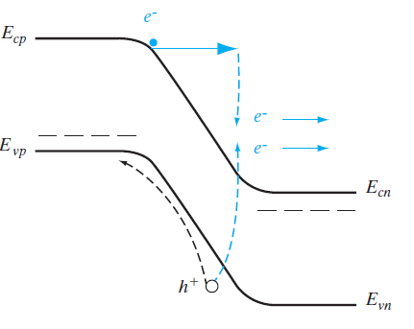
Electron-hole pairs created by impact ionization

Slide 31
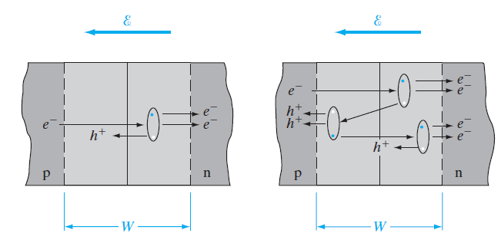
Single ionizing collision
by an incoming electron in the
depletion region of the junction
primary, secondary, and
tertiary collisions.

Slide 32
The degree of multiplication can become very high if carriers generated within the transition region also have ionizing collisions with the lattice.
For example, an incoming electron may have a collision with the lattice and create an EHP; each of these carriers has a chance of creating a new EHP, and each of those can also create an EHP, and so forth.
This is an avalanche process, since each incoming carrier can initiate the creation of a large number of new carriers.
We can make an approximate analysis of avalanche multiplication by assuming that a carrier of either type has a probability P of having an ionizing collision with the lattice while being accelerated a distance W through the transition region.

Slide 33
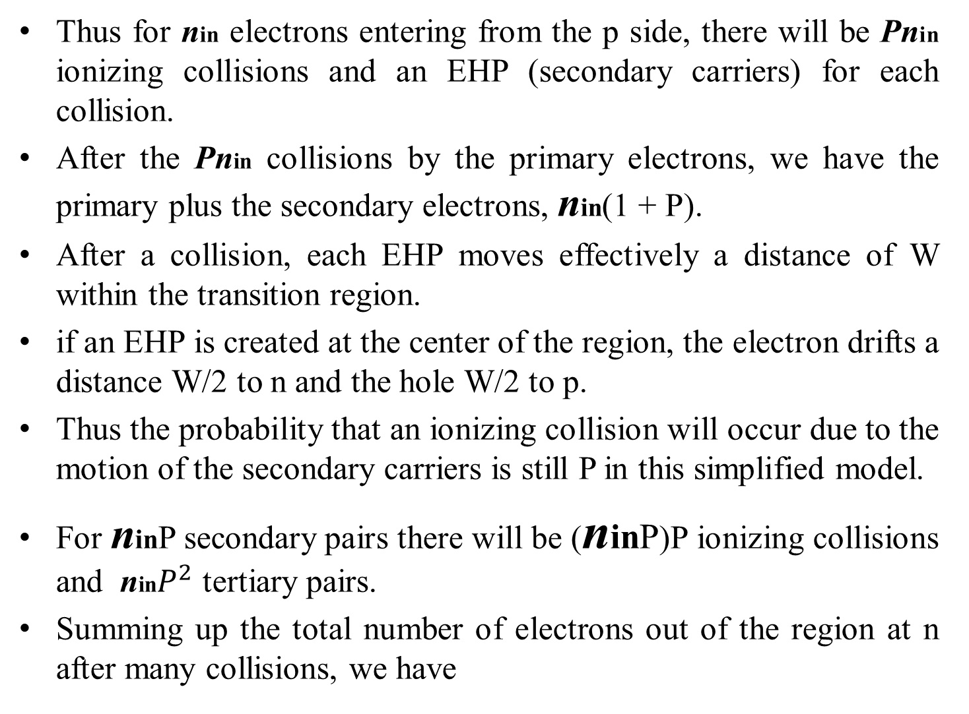
Thus for nin electrons entering from the p side, there will be Pnin ionizing collisions and an EHP (secondary carriers) for each collision.
After the Pnin collisions by the primary electrons, we have the primary plus the secondary electrons, nin(1 + P).
After a collision, each EHP moves effectively a distance of W within the transition region.
if an EHP is created at the center of the region, the electron drifts a distance W/2 to n and the hole W/2 to p.
Thus the probability that an ionizing collision will occur due to the motion of the secondary carriers is still P in this simplified model.
For ninP secondary pairs there will be (ninP)P ionizing collisions and nin$P^{2}$ tertiary pairs.
Summing up the total number of electrons out of the region at n after many collisions, we have

Slide 34


assuming no recombination.
In a more comprehensive theory we would include recombination as well as different probabilities for ionizing collisions by electrons and holes.
In our simple theory, the electron multiplication Mn is as can be verified by direct division.
As the probability of ionization P approaches unity, the carrier multiplication (and therefore the reverse current through the junction) increases without limit.
Actually, the limit on the current will be dictated by the external circuit.

Slide 35

The ionization probability increase with increasing electric field, and depends on the reverse bias.
Measurements of carrier multiplication M in junctions near breakdown lead to an empirical relation
where the exponent n varies from about 3 to 6, depending on the type of material used for the junction.

Slide 36
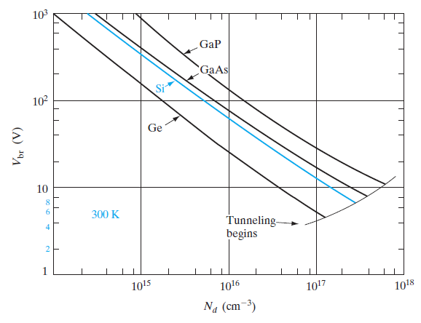
In general, the critical reverse voltage for breakdown increases with the band gap of the material, since more energy is required for an ionizing collision.
Also, the peak electric field within W increases with increased doping on the more lightly doped side of the junction.
Therefore, Vbr decreases as the doping increases

Slide 37
Rectifiers
The most obvious property of a p-n junction is its unilateral nature; that is, to a good approximation it conducts current in only one direction.
We can think of an ideal diode as a short circuit when forward biased and as an open circuit when reverse biased.
The p-n junction diode does not quite fit this description, but the I–V characteristics of many junctions can be approximated by the ideal diode in series with other circuit elements to form an equivalent circuit.
Most forward-biased diodes exhibit an offset voltage E0 , which can be approximated in a circuit model by a battery in series with the ideal diode.
The series battery in the model keeps the ideal diode turned off for applied voltages less than E0.
The actual diode characteristic is improved by adding a series resistor R to the circuit equivalent.

Slide 38
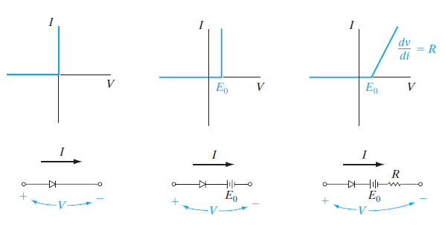
The equivalent circuit approximations illustrated in Fig are called piecewise-linear equivalents, since the approximate characteristics are linear over specific ranges of voltage and current.

Slide 39
An ideal diode can be placed in series with an a-c voltage source to provide rectification of the signal.
Since current can flow only in the forward direction through the diode, only the positive half-cycles of the input sine wave are passed.
The output voltage is a half-rectified sine wave.
Whereas the input sinusoid has zero average value, the rectified signal has a positive average value and therefore contains a d-c component.
By appropriate filtering, this d-c level can be extracted from the rectified signal.
The unilateral nature of diodes is useful for many other circuit applications that require wave shaping.
This involves alteration of a-c signals by passing only certain portions of the signal while blocking other portions.

Slide 40
Junction diodes designed for use as rectifiers should have I–V characteristics as close as possible to that of the ideal diode.
The reverse current should be negligible, and the forward current should exhibit little voltage dependence (negligible forward resistance R).
The reverse breakdown voltage should be large, and the offset voltage E0 in the forward direction should be small.
Unfortunately, not all of these requirements can be met by a single device; compromises must be made in the design of the junction to provide the best diode for the intended application.

Slide 41
For good rectifier junctions Band gap is obviously an important consideration in choosing a material for rectifier diodes.
Since ni is small for large band gap materials, the reverse saturation current (which depends on thermally generated carriers) decreases with increasing Eg.
A rectifier made with a wide band gap material can be operated at higher temperatures, because thermal excitation of EHPs is reduced by the increased band gap.
Such temperature effects are critically important in rectifiers, which must carry large currents in the forward direction and are thereby subjected to appreciable heating.
On the other hand, the contact potential and offset voltage E0 generally increase with Eg.

Slide 42
This drawback is usually outweighed by the advantages of low ni; for example, Si is generally preferred over Ge for power rectifiers because of its wider band gap, lower leakage current, and higher breakdown voltage, as well as its more convenient fabrication properties.
The doping concentration on each side of the junction influences the avalanche breakdown voltage, the contact potential, and the series resistance of the diode.
If the junction has one highly doped side and one lightly doped side (such as a p+-n junction), the lightly doped region determines many of the properties of the junction.
From Fig we see that a high-resistivity region should be used for at least one side of the junction to increase the breakdown voltage Vbr.
However, this approach tends to increase the forward resistance R of Fig., and therefore contributes to the problems of thermal effects due to I^2R heating

Slide 43
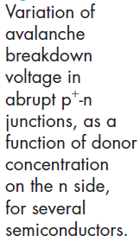

Slide 44
To reduce the resistance of the lightly doped region, it is necessary to make its area large and reduce its length.
Therefore, the physical geometry of the diode is another important design variable.
Limitations on the practical area for a diode include problems of obtaining uniform starting material and junction processing over large areas.
Localized flaws in junction uniformity can cause premature reverse breakdown in a small region of the device.
Similarly, the lightly doped region of the junction cannot be made arbitrarily short.
One of the primary problems with a short, lightly doped region is an effect called punch-through.
Since the transition region width W increases with reverse bias and extends primarily into the lightly doped region, it is possible for W to increase until it fills the entire length of this region.

Slide 45
In devices designed for use at high reverse bias, care must be taken to avoid premature breakdown across the edge of the sample.
This effect can be reduced by beveling the edge or by diffusing a guard ring to isolate the junction from the edge of the sample.
The electric field is lower at the beveled edge of the sample in Fig. 5–24b than it is in the main body of the device.
Similarly, the junction at the lightly doped p guard ring of Fig. breaks down at higher voltage than the p+-n junction.
Since the depletion region is wider in the p ring than in the p+ region, the average electric field is smaller at the ring for a given diode reverse voltage.

Slide 46
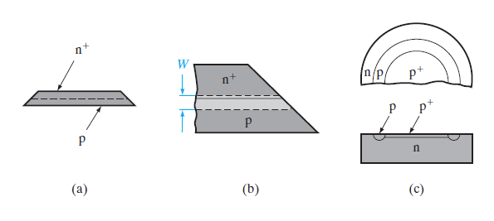

Slide 47
In fabricating a p+-n or a p-n+ junction, it is common to terminate the doped region with a heavily doped layer of the same type (Fig a)., to ease the problem of making ohmic contact to the device.
The result is a p+-n-n+ structure with the p+-n+ layer serving as the active junction, or a p+-n-n+ device with an active p+-n+ junction.
The lightly doped center region determines the avalanche breakdown voltage.
If this region is short compared with the minority carrier diffusion length, the excess carrier injection for large forward currents can increase the conductivity of the region significantly.

Slide 48
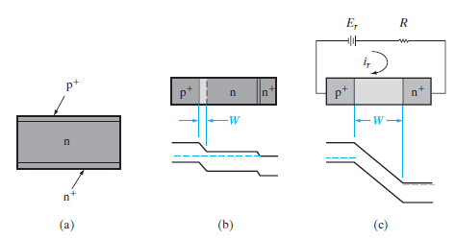
This type of conductivity modulation, which reduces the forward resistance R, can be very useful for high-current devices.
On the other hand, a short, lightly doped center region can also lead to punch-through under reverse bias, as in Fig(c).

Slide 49
The mounting of a rectifier junction is critical to its ability to handle power.
For diodes used in low-power circuits, glass or plastic encapsulation or a simple header mounting is adequate.
However, high-current devices that must dissipate large amounts of heat require special mountings to transfer thermal energy away from the junction.
A typical Si power rectifier is mounted on a molybdenum or tungsten disk to match the thermal expansion properties of the Si.

Slide 50
Optoelectronic Devices

Slide 51
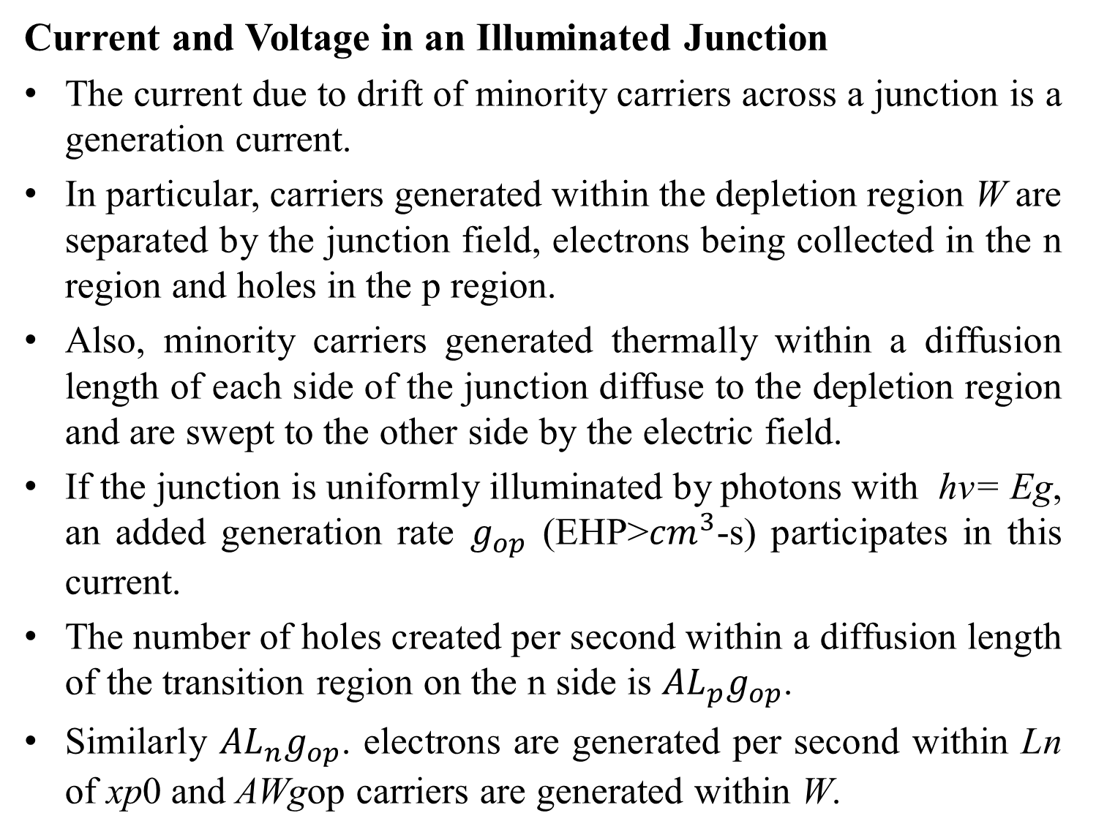
Current and Voltage in an Illuminated Junction
The current due to drift of minority carriers across a junction is a generation current.
In particular, carriers generated within the depletion region W are separated by the junction field, electrons being collected in the n region and holes in the p region.
Also, minority carriers generated thermally within a diffusion length of each side of the junction diffuse to the depletion region and are swept to the other side by the electric field.
If the junction is uniformly illuminated by photons with hv= Eg, an added generation rate $g_{op}$ (EHP>${cm}^{3}$-s) participates in this current.
The number of holes created per second within a diffusion length of the transition region on the n side is ${AL}_{p}g_{op}$.
Similarly ${AL}_{n}g_{op}$. electrons are generated per second within Ln of xp0 and AWgop carriers are generated within W.

Slide 52

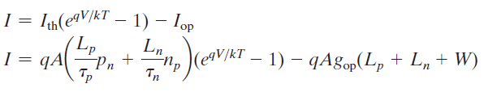
The resulting current due to the collection of these optically generated carriers by the junction is
If we call the thermally generated current described in Eq Ith, we can add the optical generation of above Eq. to find the total reverse current with illumination.
Since this current is directed from n to p, the diode equation becomes
Thus the I– V curve is lowered by an amount proportional to the generation rate.
This equation can be considered in two parts— the Current described by the usual diode equation and the current due to optical generation.

Slide 53
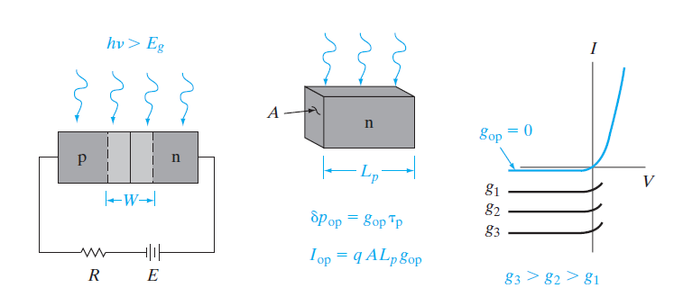

Slide 54
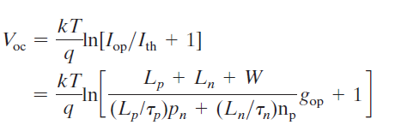
When the device is short circuited (V = 0), the terms from the diode equation cancel in Eq,as expected.
However, there is a short- circuit current from n to p equal to Iop.
Thus the I– V characteristics of Fig. cross the I-axis at negative values proportional to gop.
When there is an open circuit across the device, I = 0 and the voltage V = Voc is

Slide 55

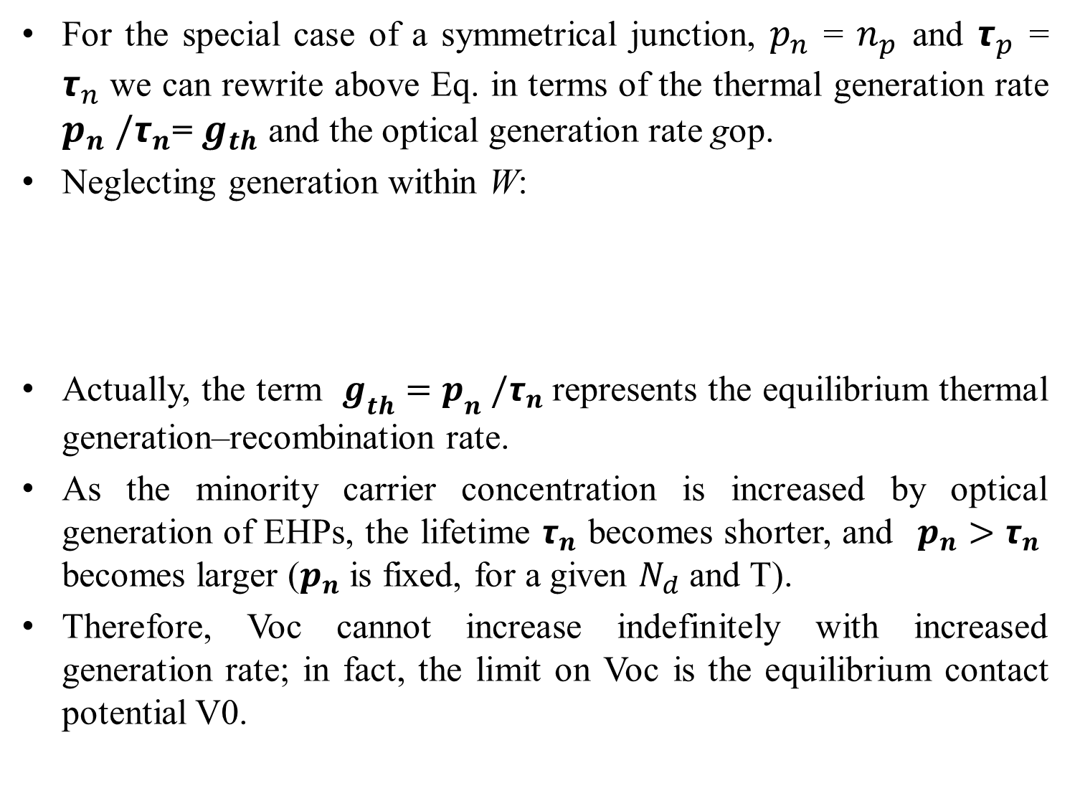
For the special case of a symmetrical junction, $p_{n}$ = $n_{p}$ and $τ_{p}$ = $τ_{n}$we can rewrite above Eq. in terms of the thermal generation rate $p_{n} /τ_{n}$= $g_{th}$ and the optical generation rate gop.
Neglecting generation within W:
Actually, the term $g_{th}{=p}_{n} /τ_{n}$represents the equilibrium thermal generation–recombination rate.
As the minority carrier concentration is increased by optical generation of EHPs, the lifetime $τ_{n}$ becomes shorter, and$p_{n}>τ_{n}$ becomes larger ($p_{n}$ is fixed, for a given $N_{d}$ and T).
Therefore, Voc cannot increase indefinitely with increased generation rate; in fact, the limit on Voc is the equilibrium contact potential V0.

Slide 56
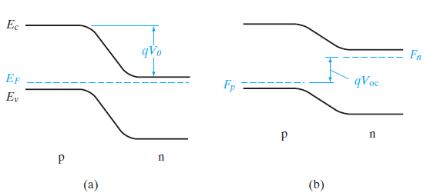
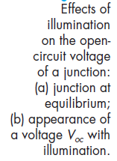
This result is to be expected, since the contact potential is the maximum forward bias that can appear across a junction.
The appearance of a forward voltage across an illuminated junction is known as the photovoltaic effect.

Slide 57
Depending on the intended application, the photodiode can be operated in either the third or fourth quarters of its I– V characteristic.
As Fig. 8– 3 illustrates, power is delivered to the device from the external circuit when the current and junction voltage are both positive or both negative (first or third quadrants).
In the fourth quadrant, however, the junction voltage is positive and the current is negative.
In this case power is delivered from the junction to the external circuit (notice that in the fourth quadrant the current flows from the negative side of V to the positive side, as in a battery).

Slide 58
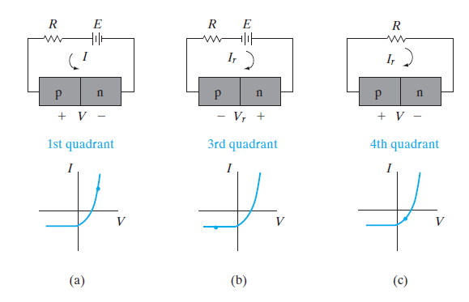
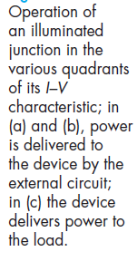
If power is to be extracted from the device, the fourth quadrant is used; on the other hand, in applications as a photodetector we usually reverse bias the junction and operate it in the third quadrant.
We shall investigate these applications more closely in the discussion to follow.

Slide 59
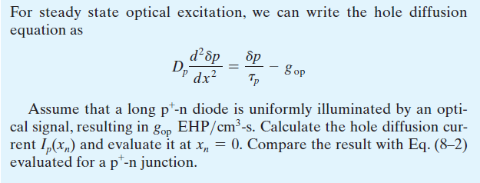

Slide 60
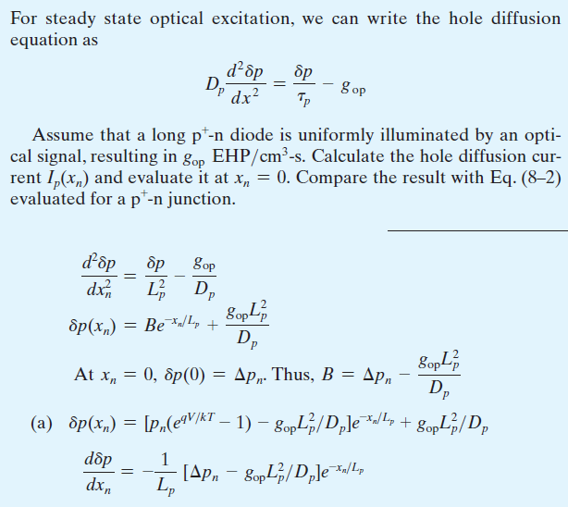


Slide 61
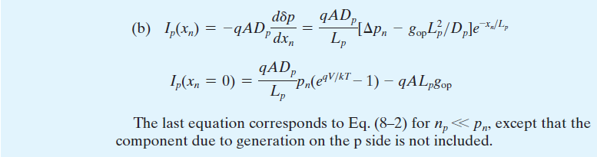

Slide 62
Solar Cells
Since power can be delivered to an external circuit by an illuminated junction, it is possible to convert solar energy into electrical energy.
If we consider the fourth quadrant of Fig. 8– 3c, it appears doubtful that much power can be delivered by an individual device.
The voltage is restricted to values less than the contact potential, which in turn is generally less than the band gap voltage Eg/q.
For Si the voltage Voc is less than about 1 V.
The current generated depends on the illuminated area, but typically Iop is in the range 10-100 mA for a junction with an area of about 1 cm2.
However, if many such devices are used, the resulting power can be significant.
In fact, arrays of p- n Junction solar cells are currently used to supply electrical power for many space satellites.

Slide 63
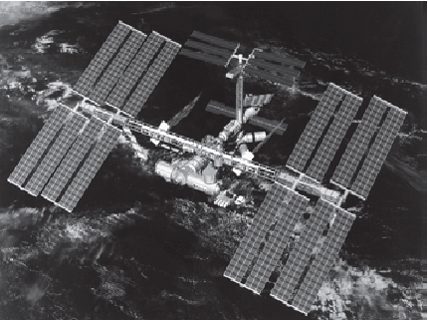
Solar cells can supply power for the electronic equipment aboard a satellite over a long period, which is a distinct advantage over batteries.
The array of junctions can be distributed over the surface of the satellite or can be contained in solar cell “paddles” attached to the main body of the satellite (Fig. 8– 4a).

Slide 64
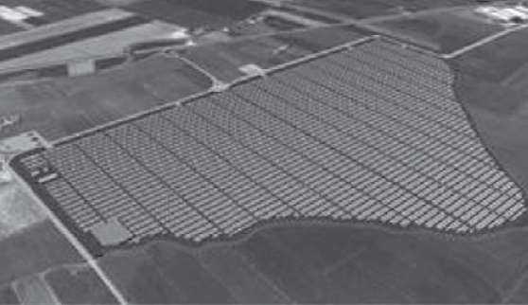
A 72MW solar cell plant in Italy is shown in Fig. 8–4b.
To utilize a maximum amount of available optical energy, it is necessary to design a solar cell with a large area junction located near the surface of the device (Fig. 8– 5).
The planar junction is formed by diffusion or ion implantation, and the surface is coated with appropriate materials to reduce reflection and to decrease surface recombination.
Many compromises must be made in solar cell design.

Slide 65
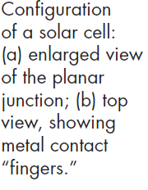
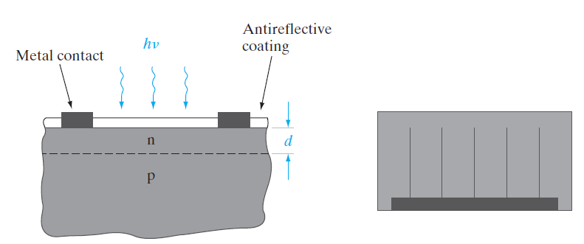

Slide 66
In the device shown in Fig. 8– 5, for example, the junction depth d must be less than Lp in the n material to allow holes generated near the surface to diffuse to the junction before they recombine; similarly, the thickness of the p region must be such that electrons generated in this region can diffuse to the junction before recombination takes place.
This requirement implies a proper match between the electron diffusion length Ln, the thickness of the p region, and the mean optical penetration depth 1/𝞪 .
It is desirable to have a large contact potential V0 to obtain a large photovoltage, and therefore heavy doping is indicated; on the other hand, long lifetimes are desirable and these are reduced by doping too heavily.
It is important that the series resistance of the device be very small so that power is not lost to heat due to ohmic losses in the device itself.

Slide 67
A series resistance of only a few ohms can seriously reduce the output power of a solar cell .
Since the area is large, the resistance of the p-type body of the device can be made small.
However, contacts to the thin n region require special design.
If this region is contacted at the edge, current must flow along the thin n region to the contact, resulting in a large series resistance.
To prevent this effect, the contact can be distributed over the n surface by providing small contact fingers as in Fig. 8– 5b.
These narrow contacts serve to reduce the series resistance without interfering appreciably with the incoming light.

Slide 68
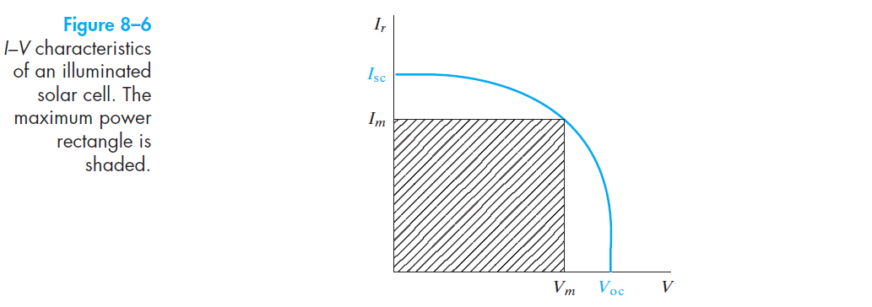

Slide 69
Figure 8– 6 shows the fourth- quadrant portion of a solar cell characteristic, with Ir plotted upward for the convenience of illustration.
The open- circuit voltage Voc and the short- circuit current Isc are determined for a given light level by the cell properties.
The maximum power delivered to a load by this solar cell occurs when the product VIr is a maximum.
Calling these values of voltage and current Vm and Im, we can see that the maximum delivered power illustrated by the shaded rectangle in Fig is less than the Isc.Voc product.
The ratio ImVm/IscVoc is called the fill factor, and is a figure of merit for solar cell design.
Applications of solar cells are not restricted to outer space.
It is possible to obtain useful power from the sun in terrestrial applications using solar cells, even though the solar intensity is reduced by the atmosphere

Slide 70

Current worldwide total power generation capability is 15 TW and corresponds to an annual energy usage of 500 quads (1 quad = 1015, or a quadrillion, BTU), with an annual increase of 1-2%.
Of this 80% comes from fossil fuels (oil, natural gas, and coal), which will be exhausted in several hundred years.
In addition, CO2 emissions and global warming have spurred a renewed interest in “green” sources of energy such as photovoltaics, of which the current installed capacity worldwide is about 100 GW.
About 1 kW/$m^{2}$is available in a particularly sunny location (translating to about 600 TW potentially available worldwide), but not all of this solar power can be converted to electricity.

Slide 71
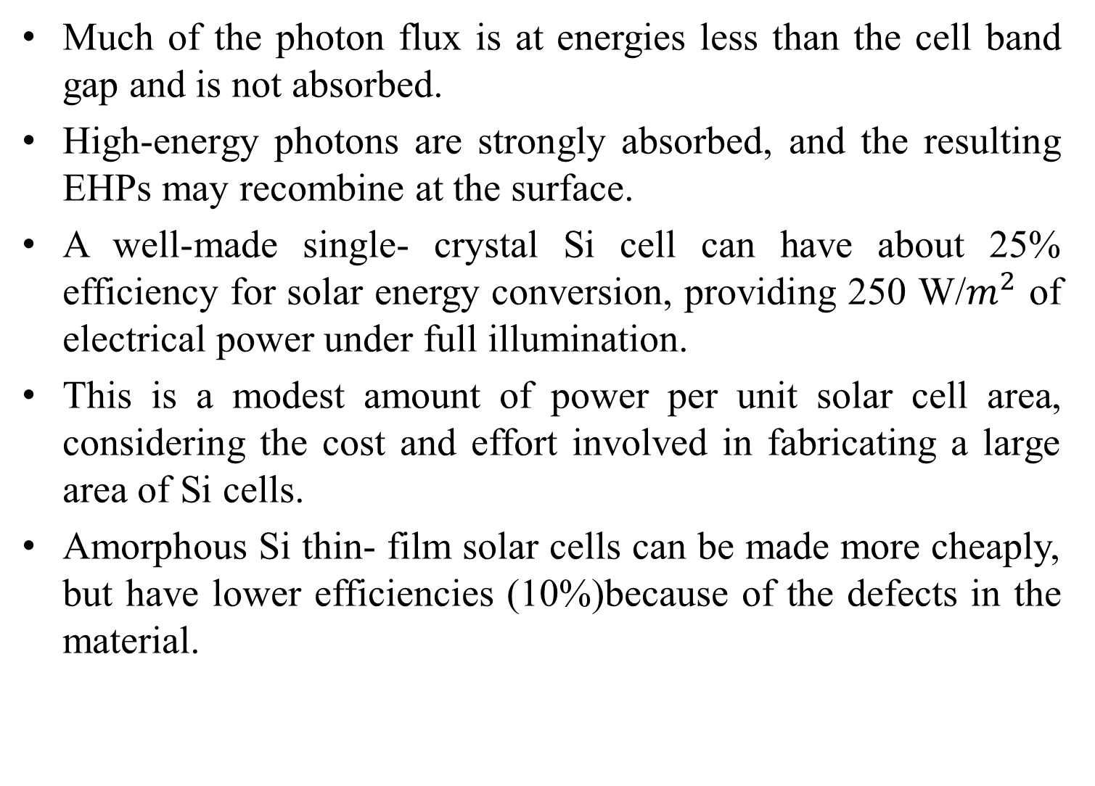
Much of the photon flux is at energies less than the cell band gap and is not absorbed.
High-energy photons are strongly absorbed, and the resulting EHPs may recombine at the surface.
A well-made single- crystal Si cell can have about 25% efficiency for solar energy conversion, providing 250 W/$m^{2}$ of electrical power under full illumination.
This is a modest amount of power per unit solar cell area, considering the cost and effort involved in fabricating a large area of Si cells.
Amorphous Si thin- film solar cells can be made more cheaply, but have lower efficiencies (10%)because of the defects in the material.

Slide 72
The cost and scalability of photovoltaic technology are of paramount importance for terrestrial applications.
Currently, it costs only about 3 cents per kWh for electricity generation from fossil fuels, but about 10 times that amount from amorphous Si solar cells, and the time to recover the investment in photovoltaics is about four years.
In terms of scalability, at 10% cell efficiency, approximately 3% of the land area would have to be covered with solar cells to meet US energy needs, which would, of course, create other environmental problems.
One approach to obtaining more power per cell is to focus considerable light onto the cell with the use of mirrors.
Although Si cells lose efficiency at the resulting high temperatures, GaAs and related compounds can be used at 100°C or higher.

Slide 73
In such solar concentrator systems, more effort and expense can be put into the solar cell fabrication, since fewer cells are required.
For example, a GaAs– AlGaAs heterojunction cell provides good conversion efficiency and operates at the elevated temperatures that are common in solar concentrator systems.
In such systems, the area required is shifted from the cell to the concentrator.

Slide 74
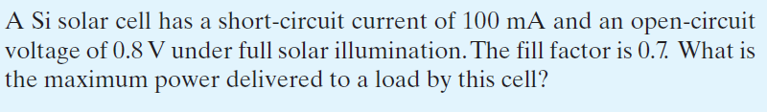

Slide 75
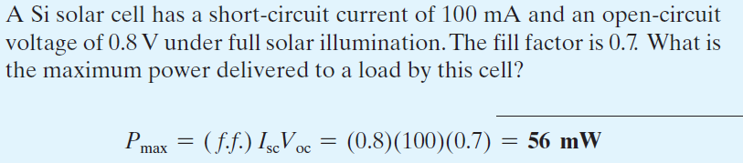

Slide 76
Photodetectors
When the photodiode is operated in the third quadrant of its I–V characteristic (Fig. 8– 3b), the current is essentially independent of voltage but is proportional to the optical generation rate.
Such a device provides a useful means of measuring illumination levels or of converting time- varying optical signals into electrical signals.
In most optical detection applications the detector’s speed of response, or bandwidth, is critical.
For example, if the photodiode is to respond to a series of light pulses 1 ns apart, the photogenerated minority carriers must diffuse to the junction and be swept across to the other side in a time much less than 1 ns.
The carrier diffusion step in this process is time consuming and should be eliminated if possible.
Therefore, it is desirable that the width of the depletion region W be large enough so that most of the photons are absorbed within W rather than in the neutral p and n regions.

Slide 77
When an EHP is created in the depletion region, the electric field sweeps the electron to the n side and the hole to the p side.
Since this carrier drift occurs in a very short time, the response of the photodiode can be quite fast.
When the carriers are generated primarily within the depletion layer W, the detector is called a depletion layer photodiode.
The appropriate width for W is chosen as a compromise between sensitivity and speed of response.
If W is wide, most of the incident photons will be absorbed in the depletion region, leading to a high sensitivity.
Also, a wide W results in a small junction capacitance , thereby reducing the RC time constant of the detector circuit.

Slide 78
On the other hand, W must not be so wide that the time required for drift of photogenerated carriers out of the depletion region is excessive, leading to low bandwidth.
One convenient method of controlling the width of the depletion region is to build a p- i- n photodetector. (Fig. 8– 7).
The “i” region need not be truly intrinsic, as long as the resistivity is high.
It can be grown epitaxially on the n- type substrate, and the p region can be obtained by implantation.

Slide 79
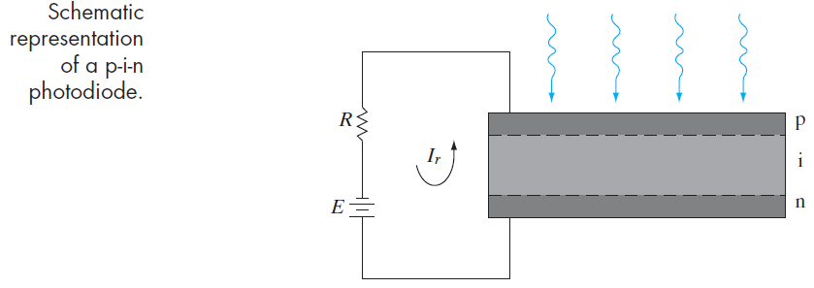

When this device is reverse biased, the applied voltage appears almost entirely across the i region.
If the carrier lifetime within the i region is long compared with the drift time, most of the photogenerated carriers will be collected by the n and p regions.
An important figure of merit for a photodetector is the external quantum efficiency $η_{Q}$, defined as the number of carriers that are collected for every photon impinging on the detector.

Slide 80

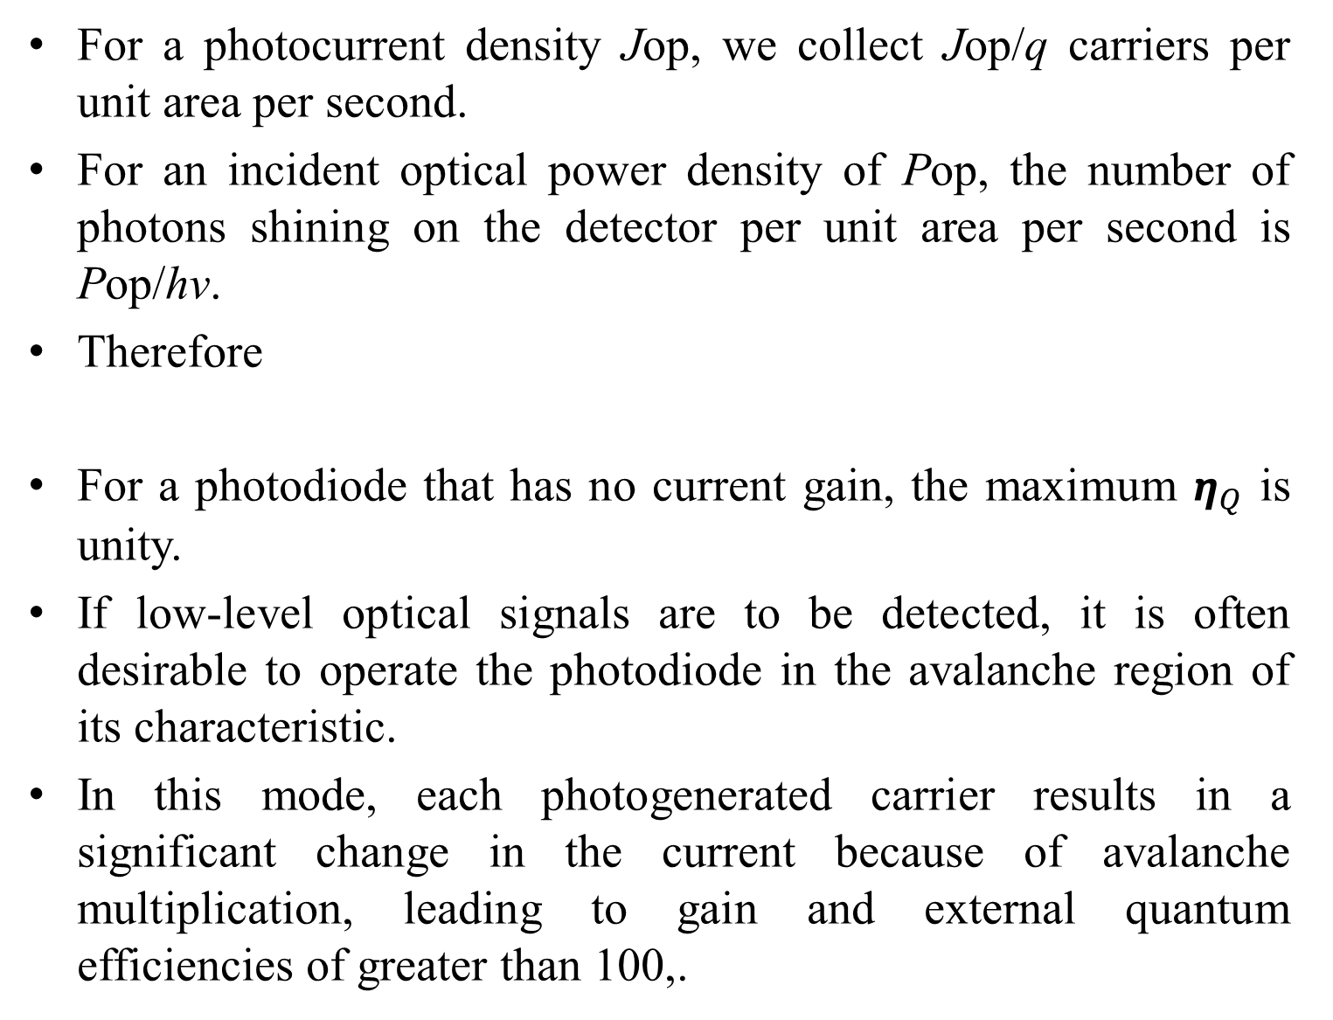
For a photocurrent density Jop, we collect Jop/q carriers per unit area per second.
For an incident optical power density of Pop, the number of photons shining on the detector per unit area per second is Pop/hv.
Therefore
For a photodiode that has no current gain, the maximum $η_{Q}$ is unity.
If low-level optical signals are to be detected, it is often desirable to operate the photodiode in the avalanche region of its characteristic.
In this mode, each photogenerated carrier results in a significant change in the current because of avalanche multiplication, leading to gain and external quantum efficiencies of greater than 100,.

Slide 81
Avalanche photodiodes (APDs) are useful as detectors in fiber- optic systems
The type of photodiode described here is sensitive to photons with energies near the band gap energy (intrinsic detectors).
If hv is less than Eg, the photons will not be absorbed; on the other hand, if the photons are much more energetic than Eg, they will be absorbed very near the surface, where the recombination rate is high.
Therefore, it is necessary to choose a photodiode material with a band gap corresponding to a particular region of the spectrum.
Detectors sensitive to longer wavelengths can be designed such that photons can excite electrons into or out of impurity levels (extrinsic detectors).
However, the sensitivity of such extrinsic detectors is much less than intrinsic detectors, where EHPs are generated by excitation across the band gap.

Slide 82
By using lattice- matched multilayers of compound semiconductors, the band gap of the absorbing region can be tailored to match the wavelength of light being detected.
Wider band gap material can then be used as a window through which the light is transmitted to the absorbing region.
The composition of InGaAs has a band gap of about 0.75 eV, which is sensitive to a useful wavelength for fiber- optic systems (1.55 𝞵m).
In making a photodiode using InGaAs as the active material, it is possible to bring the light through the wider band gap In0.52Al0.48As (also lattice- matched to InP), thus greatly reducing surface recombination effects.
In the case of APDs requiring narrow- band- gap material, it is often advantageous to absorb the light in the narrow-gap semiconductor (e.g., InGaAs) and transport the resulting carriers to a junction made in wider band gap material (e.g., InAlAs), where the avalanche multiplication takes place at high fields.

Slide 83
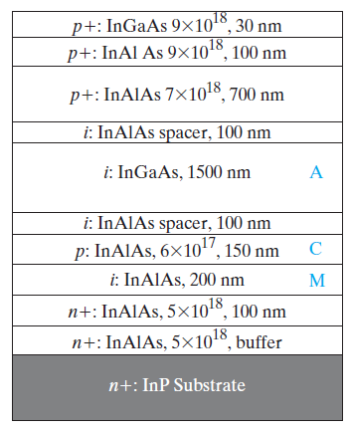
Such a separation of the absorption and multiplication APDs avoids the excessive leakage currents typical of reverse- biased junctions in narrow- gap materials.
In this particular structure, there is also a doped InAlAs charge layer, leading to a SACM APD, which helps optimize (decrease) the electric field further between the multiplication and absorption regions.

Slide 84
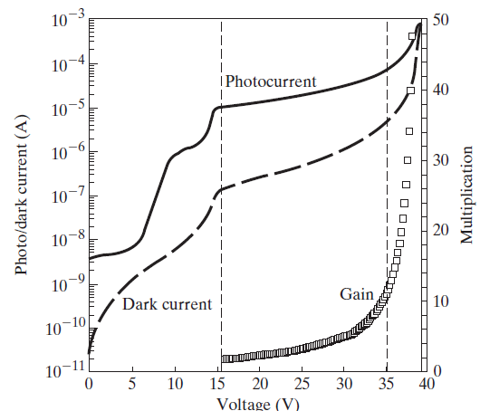
In certain APDs, one can grade the alloy composition between the high- band- gap multiplication regions and the lower- band- gap absorption region to avoid any band- edge discontinuities, which can trap photogenerated carriers.
The photocurrent and dark current both increase with bias because of avalanche multiplication (Fig. 8– 8b).
One obviously wants to maximize the difference 𝞓I between the photocurrent Ip and the dark current Id.
The ratio of 𝞓I at different voltages to that at a low reference voltage is defined as the gain of the APD.

Slide 85
Light Emitting Diodes
When carriers are injected across a forward- biased junction, the current is usually accounted for by recombination in the transition region and in the neutral regions near the junction.
In a semiconductor with an indirect band gap, such as Si or Ge, the recombination releases heat to the lattice.
On the other hand, in a material characterized by direct recombination, considerable light may be given off from the junction under forward bias.
This effect, called injection electroluminescence (Section 4.2.2), provides an important application of diodes as generators of light.
The use of LEDs in digital displays is well known.
There are also other important applications, in traffic and automotive signals and in illumination.
Another important device making use of radiative recombination in a forward- biased p-n junction is the semiconductor laser.

Slide 86
Lasers emit coherent light in much narrower wavelength bands than LEDs, with more collimation (directionality), and are very useful for fiber- optic communication systems.
For LEDs, the frequency (color) of the photon is governed by the band gap of the semiconductor as given by the Planck relation, hv = Eg, which, in appropriate units, can be expressed as Eg (eV) = 1.24 / 𝞴 (𝞵m).
A very important metric of an LED is the external quantum efficiency 𝞰ext, which is defined as the light output divided by the electrical input power:

Slide 87
The internal efficiency is a function of the quality of the material and the structure and composition of the layer.
Defects in the material will clearly lead to nonradiative recombination.
However, even if the internal efficiency is high, not all emitted photons are extracted from the LED.
The emitted photons from an LED have a wide angular distribution, unlike those in a laser.
For example, if an LED had a planar surface, the photons incident on the semiconductor– air interface at angles greater than a critical angle would undergo total internal reflection and ultimately be lost via absorption within the semiconductor.
Hence, typically, LEDs are made with a dome- type encapsulation, which acts as a lens so that more of the photons can be extracted.

Slide 88
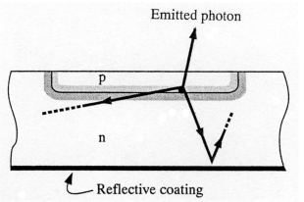

The external quantum efficiency quantifies the conversion efficiency of electrical energy into an emitted external optical energy.
It incorporates the internal quantum efficiency and the subsequent efficiency of photon extraction from the device

